Slide 1
Qualitative effects
Focal Regions as Attractors

Slide 2
Qualitative effects
Model: P(k,i,s,j) = Bias_{k} + α*Sigmoid(s, β, γ)*I(k,i)*Focal(k)
+ δ*sim(k,i,ε)*Focal(k)
+ ζ*sim(k⁻¹,j,η) *Focal(k)
Model: P(k,i,s,j) = Bias_{k} + α*Sigmoid(s, β, γ)*I(k,i)*Focal(k)
+ δ*Sigmoid(FRAsim(k,i,j),ε, ζ)*Focal(k)
Model: P(k,i,s) = Bias_{k}*(1 + Sigmoid(FRAsim(k,i,j), δ, ε)*Focal(k))
+ α*Sigmoid(s, β, γ)*I(k,i)*Focal(k)
sim(k,i,ε)=exp(-ε*dist(k,i))
FRAsim(k,i,j)=sim(k,i)+sim(k⁻¹,j)
sim(k,i)=Intersection(k,i)/Union(k,i)
No model
parameters
so can be visualized
and fitted!
k: region in grid; i: region visited on last round; s: score obtained on last round; j: overlapping region on last round

Slide 3
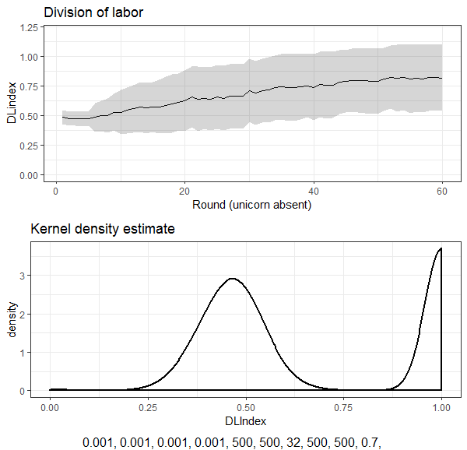
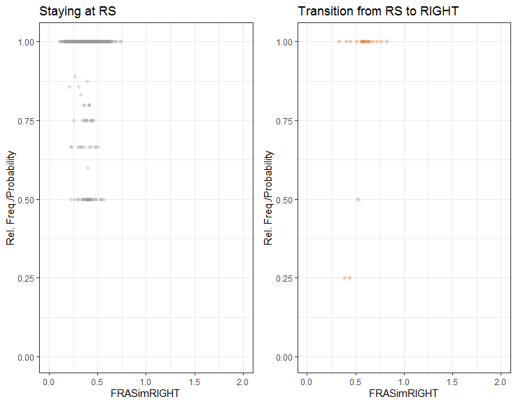
Qualitative effects FRASim

Slide 4
FRAsim as a threshold mechanism
Behavioral data

Slide 5
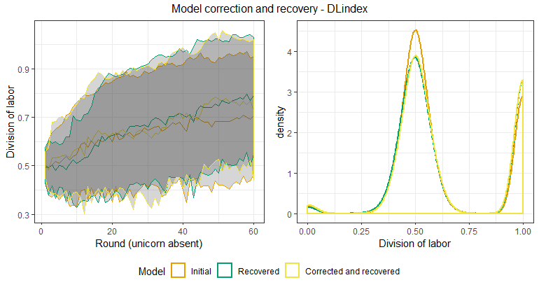
Sample variation (size =50)

Slide 6
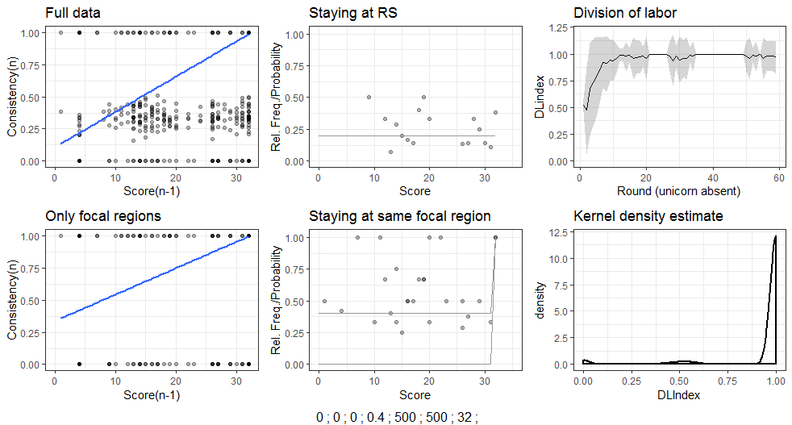
Qualitative effects (2 focal regions – high)

Slide 7
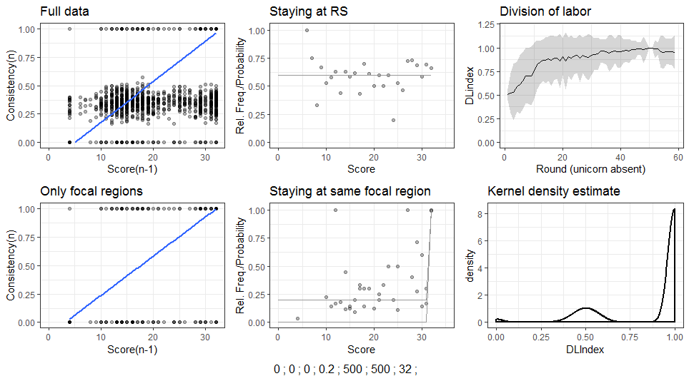
Qualitative effects (2 focal regions – medium)

Slide 8
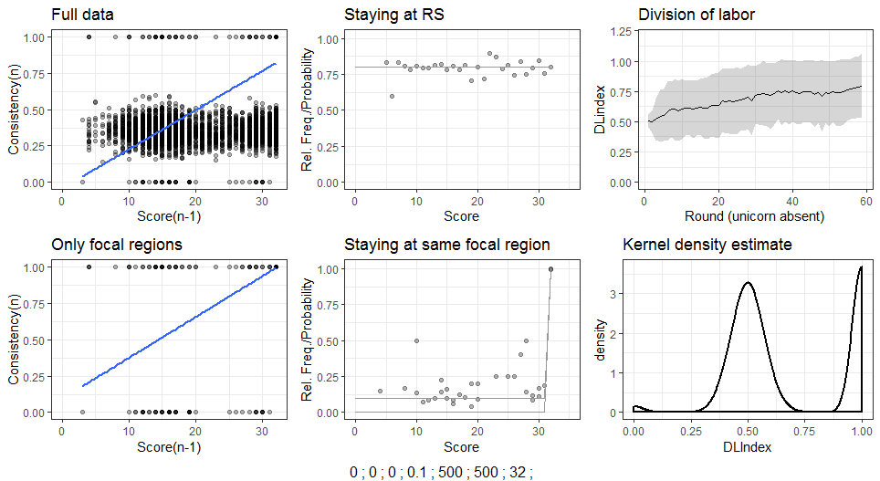
Qualitative effects (2 focal regions – low)

Slide 9
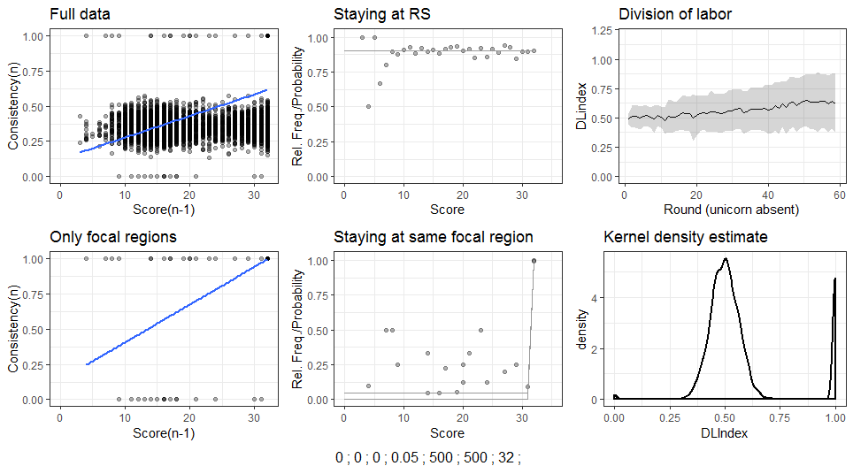
Qualitative effects (2 focal regions – too low)

Slide 10
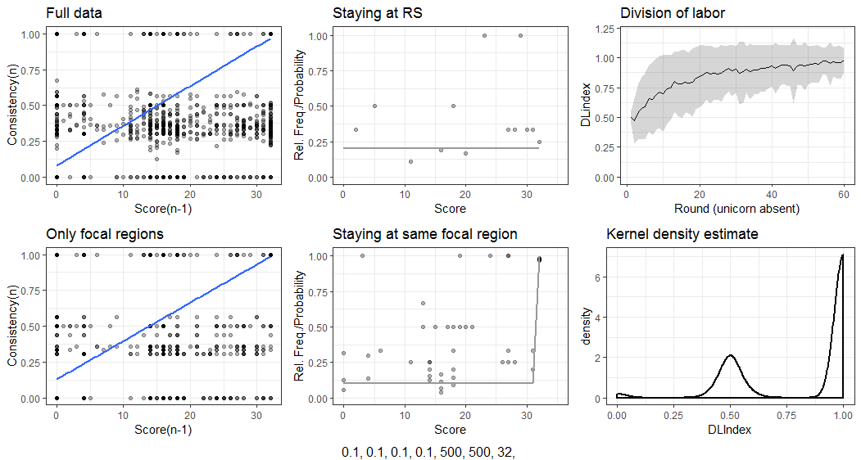
Qualitative effects (8 focal regions – high)

Slide 11
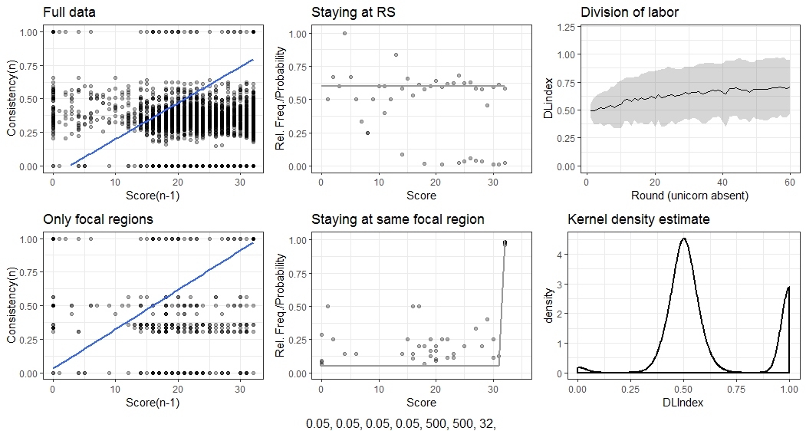
Qualitative effects (8 focal regions – medium)

Slide 12
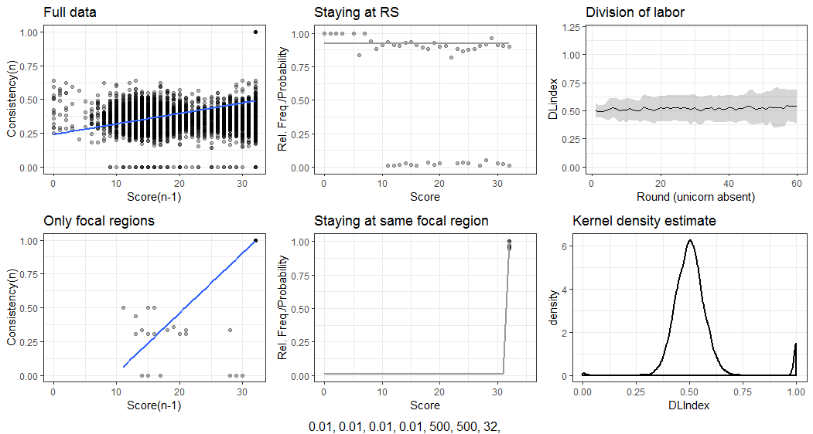
Qualitative effects (8 focal regions – low)

